Slide 1
Multivariate normal density
https://www.projectrhea.org/rhea/index.php/Lecture_12_-_Support_Vector_Machine_and_Quadratic_Optimization_Problem_OldKiwi
Case 1
Case 2
Case 3

Slide 2
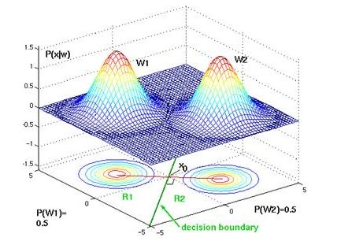
Case 1

Slide 3
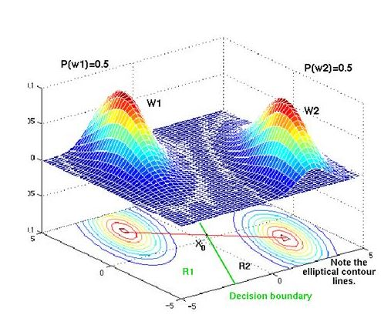
Case 2

Slide 4
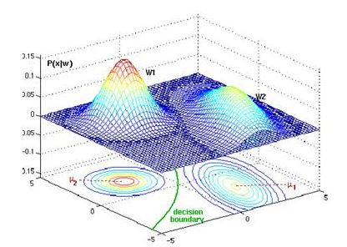
Case 3

